Slide 1
Where to eat vegetarian dinner?

Slide 2
We analyzed 5 cities
Amsterdam
Rotterdam
Utrecht
Breda
Den haag

Slide 3

We used this code from foursquare and connected to the api

Slide 4
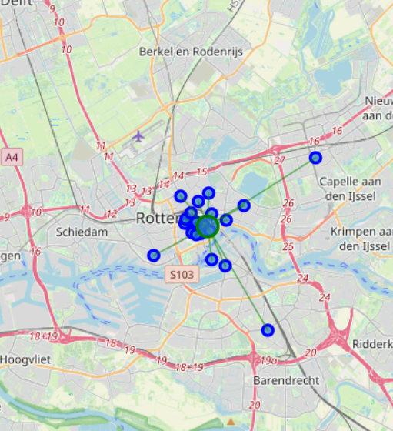
The winner is Rotterdam based on Euclidian distance

